Slide 1
Azure Functions
Mehdi Khaleghian
Notes:
http://news.genius.com/Marc-andreessen-why-software-is-eating-the-world-annotated

Slide 2
What we are going to cover
What is Serverless Computing?
Players in the market?
Azure Serverless offerings
Azure Function App and Functions
Hosting plans
Triggers and Bindings
VS 2017 tooling
Demos (Portal, Visual Studio 2017)
Local Debugging and remote debugging

Slide 3
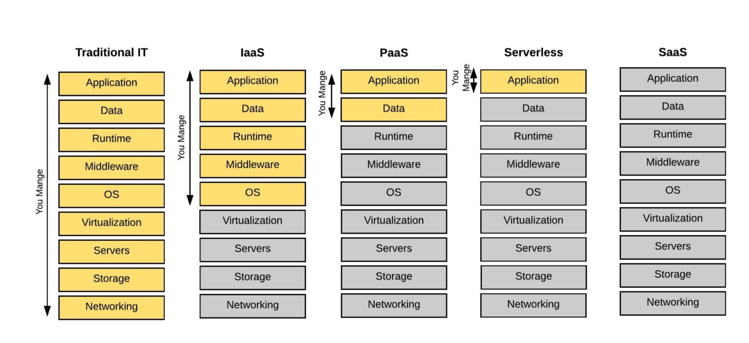
What is serverless?

Slide 4
Serverless Computing
Is an architecture
Abstraction of servers, infrastructure and operating systems
Driven by reactions and triggers happening in real time in the cloud
Focus on the core logic and business
No time on infrasture
Focus is on the core logic of what needs to be done
Cost effective/ billing is based on resources being consumed or the actual time your code is running
Reduced time to market/bring apps to market faster
Reduced DevOps
https://azure.microsoft.com/en-au/overview/serverless-computing/

Slide 5
Serverless Hosting Providers
Amazon: AWS Lambda
Microsoft: Azure Functions
Google: Cloud Functions
IBM Bluemix + OSS: OpenWhisk
OSS: Fission.io
https://headmelted.com/serverless-showdown-4a771ca561d2

Slide 6
Azure Serverless offerings
Azure Functions – Serverless Computing
Azure Logic Apps – Serverless Workflows
Event Grid – Serverless event routing
Notes:
These are wording from an old document

Slide 7
Azure Function App and Functions
Insert a few paragraphs of text (example below of suitable length). Ensure you are talking at a business level not at the technical level and addressing how Readify can solve business problems / provide competitive advantage through disruptive software innovation. That we can be a ‘trusted advisor’ and provide technology strategy consulting.
Everyone is talking about cloud and mobility today and the way that they are disrupting current business models. But what if your business had the ability to look forward at current technology trends and predict how those will impact your industry and be ready to take advantage of those technologies earlier?
Technology strategy is fast becoming a critical ingredient to running a successful business and at Readify we excel at understanding current and emerging technology trends and applying them to your business challenges and positioning your organisation for the future.
Identifying meaningful ways that technology such as mobility can improve customer engagement.
Taking advantage of the economic benefits of cloud computing in a principled way.
Introducing new approaches to collaboration which blend seamlessly with the way you work.
Reducing the cost of legacy systems through staged modernisation approaches.

Slide 8


Hosting Plans
Readify helps customers succeed by developing and supporting innovative software projects that solve business problems.
Subtitle
Strategy
Design
Deliver
Sustain
Enterprise Architecture
Platform Selection
Business optimisation
Emerging trends
Roadmap
Architecture
UX
UI
Branding
User adoption
Software development
Application Integration
Platform deployment
Business Intelligence / Big Data
Cloud
Mobility
Project Management Services
Support
Mentoring
Training

Slide 9
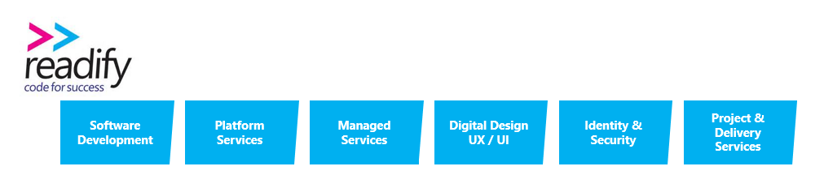
Triggers and Bindings

Slide 10
Demo in Azure Portal

Slide 11
Visual Studio 2017 tooling improvements
Notes:
Local Listed:
Oakton
Empired
SMS
DWS
Technology One
Data#3
Global Listed:
DiData
Fujitsu
IBM GS

Slide 12
Local Debugging
Customers value our capacity to understand their business and apply our software expertise to consistently deliver great results, and great value, every time.
Our ability to help customers is a direct result of applying best practice software development processes and employing elite developers.
We do this through a rigorous, peer-driven recruitment process and then continue to invest in our people's development; ensuring their skills remain at the forefront of industry knowledge. Customers gain confidence from Readify's knowledge and mastery of constantly changing subject matter.

Slide 13
Remote Debugging

Slide 14
Conclusion
There is a new reality where technology and software is a fundamental business service.
Readify is a differentiated software services player with a long and outstanding track record of profitability and sustainable growth.
Compelling market fundamentals underpinning strong growth, including increased investment in mobile applications, data analytics, and the cloud.
Differentiated through its renowned technologists and disruptive solutions, not just resources for legacy projects.
A loyal annuity customer base where 85% of revenues from repeat customers (c.50% of revenues from customers of 5+ years).
Impressive organic revenue growth (c.20%+) since 2007 delivered by a highly capable team.
A leader amongst leaders with numerous industry accolades.

Slide 15
Useful Links "“The dream as conceived 25 years ago has not been achieved. Until software becomes the ultimate tool for collaboration, productivity, and efficiency, the work is not done. And there's nothing more fun than doing that work.”
Larry Page
Notes:
That why we are talking to you.

